Slide 1
Cake Shop
HACKTHON 1.0
Presented by:-
• RAJPUT PARESh
•SONAWne ANIKET
•PATOLE ROHIT
•SHIMPI JAYESH
•PAWAR DIVYESH

Slide 2
Introduction
Technologies We Have Used :-
HTML
CSS
Online cake delivery is gaining more popularity among people all over the world. The cake is the first and foremost thing to be required for celebrating any kind of event. Gone are the days, birthday is the one and the only event celebrated with a cake. Now, the trend has changed no other celebrations get fulfilled without cutting a cake. The cake varieties and flavors displayed at the online stores are mind-blowing which attracts huge numbers of people from all corners of the world. Online cake delivery is appreciated by the people, which saves a lot of time and money for the customers while buying a cake for all the occasions. The offers and facilities offered by the online platform are amazing, where the customers have a chance to enjoy the maximum level of benefits. Let see the significant reasons for choosing the online cake delivery system.

Slide 3
Objectives
Online Booking
Saves Time
Social Distancing

Slide 4
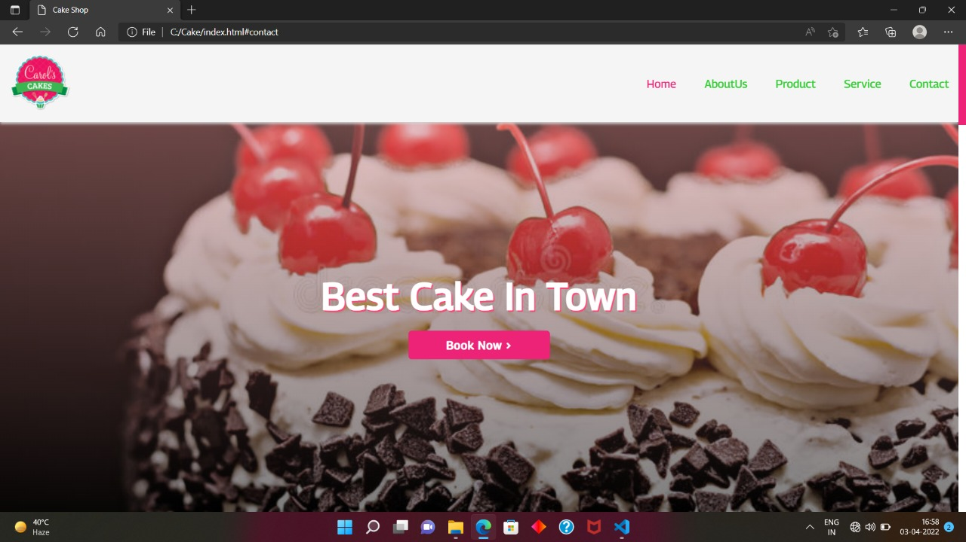
HOME PAGE
Notes:
HOME PAGE

Slide 5
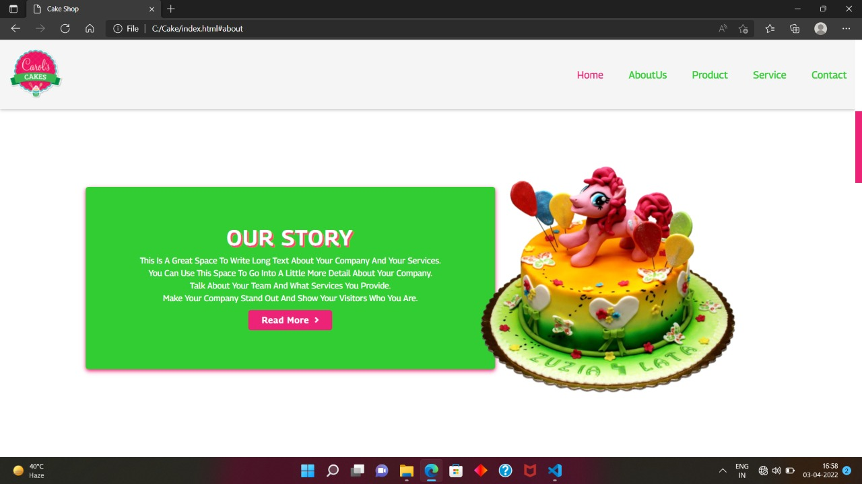
ABOUT US

Slide 6
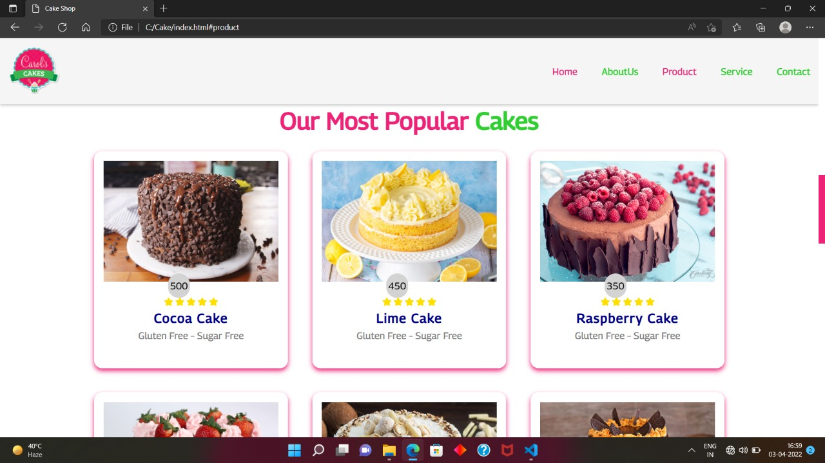
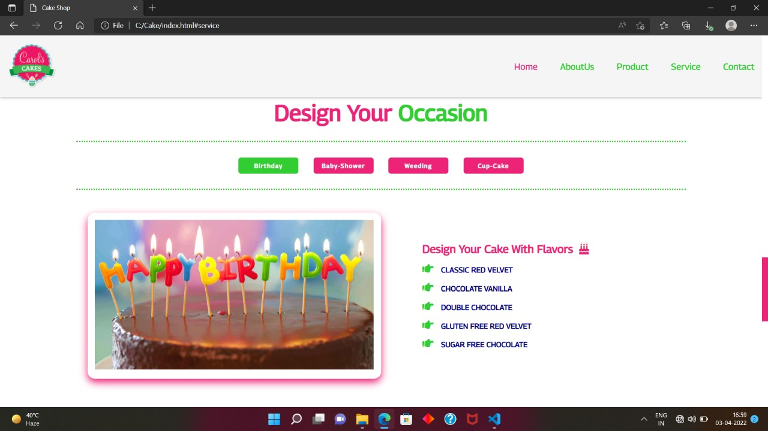
PRODUCT
SERVICE

Slide 7
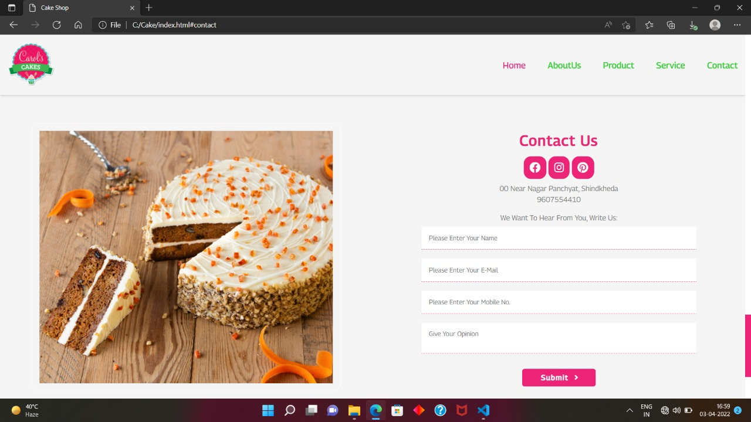
CONTACT US

Slide 8
THANK YOU 😊❤️

